Slide 1
From Caesar to Vigenère
Evolution of Substitution Ciphers
CSA5116-Cryptography and Network Security
about how people have hidden secret messages by replacing letters, and how the methods improved over time.
H
E
L
L
O
+3
K
H
O
O
R
- G.DHANUSHA SREE (192325012)
CO1-AT3 Technical Presentation

Slide 2
Basic Terms
2
Plaintext
Original message
Ciphertext
Secret message
Encryption / Decryption
Converting back and forth
Key
The secret that controls the process
Substitution cipher
Each letter is replaced by another letter

Slide 3
Caesar Cipher (about 50 BC)
3
Shift every letter by a fixed number
Example (shift 3): HELLO → KHOOR
Key = shift number (1 to 25)
Formula: C = (P + k) mod 26 ,
C=(C-K)mod 26
Weakness: only 25 keys, so brute force breaks it instantly
Plain
H
E
L
L
O
↓ shift +3
Cipher
K
H
O
O
R

Slide 4
Monoalphabetic Substitution (AD 500 to AD 1500)
4
In monoalphabetic substitution, each letter is replaced by another letter using a fixed key
It makes the message harder to understand without knowing the key.
But one letter always maps to the same letter
Plain
A
B
C
D
E
F
G
H
↓
Cipher
Q
W
E
R
T
Y
U
I

Slide 5
Vigenère Cipher (16th century)
6
Uses a keyword, repeated along the message
Each key letter gives a different Caesar shift
Same plaintext letter → different ciphertext letters
Called "the indecipherable cipher" for about 300 years
Plaintext
A
T
T
A
C
K
A
T
D
A
W
N
Key: LEMON
L
E
M
O
N
L
E
M
O
N
L
E
Ciphertext
L
X
F
O
P
V
E
F
R
N
H
R

Slide 6
Weakness: Frequency Analysis
5
Discovered by Al-Kindi (9th century)
In English, E, T, A, O are the most common letters
The most common letter in the ciphertext probably means E

Slide 7
Comparison
7
 | Caesar | Monoalphabetic | Vigenère
Key | One number | Scrambled alphabet | Keyword
Keys | 25 | 26! | 26ⁿ
Frequency hidden? | No | No | Yes
Difficulty to break | Very easy | Medium | Hard

Slide 8
Breaking Vigenère and Practical Experiment
8
Broken by Babbage and Kasiski (1850s to 1863): repeated patterns reveal the key length.
1
2
3
4
Encrypt one paragraph with all three ciphers
Plot letter-frequency graphs
Break Caesar (brute force) and substitution (frequency)
Find the Vigenère key length
Experiment has four steps

Slide 9
Results and Analysis
9
Substitution: shape preserved, easy to guess
Vigenère: frequency analysis fails
Every cipher fixed the last weakness, but all were eventually broken
Illustrative graphs

Slide 10
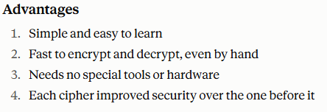
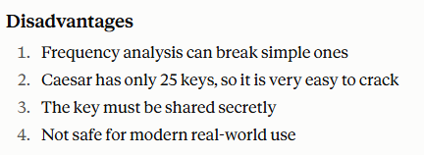
10

